Slide 1

ML.NET – Machine Learning for .NET
Machine Learning, ML.NET, AutoML
SoftUni Team
Technical Trainers
Software University
http://softuni.bg

Slide 2
Table of Contents
What is Machine Learning?
Introduction to ML.NET
Binary classification
Multi-class classification
Recommendation
Regression
Clustering
Anomaly Detection
Computer Vision
AutoML and ML.NET for ASP.NET Core

Slide 3
Have a Question?
sli.do #csharp-web

Slide 4
What is Machine Learning?
Scientific study of algorithms and statistical models
ML algorithms build a mathematical model based on sample data (training data), in order to make predictions or decisions without being explicitly programmed to perform the task
It is seen as a subset of artificial intelligence
AI = Mimicking the human intelligence or behavioral
Deep learning is part of a broader family of machine learning methods based on artificial neural networks
Artificial Intelligence NLP, Robotics, Vision, ML, etc.
Machine Learning
Deep Learning
Neural Networks

Slide 5

Types of Machine Learning
Supervised Learning
Learning a function that maps an input to an output based on example pairs
Unsupervised Learning
Helps find previously unknown patterns in data set without pre-existing labels
Reinforcement Learning
Concerned with how software agents ought to take actions in an environment so as to maximize some notion of cumulative reward

Slide 6
Typical Developer Steps in Machine Learning
Gather Data
Select Algorithm
Evaluate the Model
Clean and Prepare Data
Train a Model
Use the Model

Slide 7
What is ML.NET?
Cross-platform machine learning framework for .NET (both C# and F#)
Open source: https://github.com/dotnet/machinelearning
Powers Windows Hello, Bing Ads, PowerPoint Design Ideas, and more
Leverage other popular ML libraries like Infer.NET, TensorFlow and ONNX
High performance and accuracy [paper]
Easy to integrate ML into .NET apps without any prior ML experience
NuGet package: Microsoft.ML, Current version: 1.2.0
It automatically create model builders and select best ML algorithm
Package for ASP.NET Core: Microsoft.Extensions.ML

Slide 8
Typical Steps in ML.NET
Create context (context = new MLContext())
Load the data (dataView = context.Data.…<Input>(…))
Create pipeline and transform data (pipeline = context.Transforms ...)
Select and configure the training algorithm (Regression, Clustering, ...)
Add the trainer to the pipeline (pipeline.Append(trainer))
SaveFit the data into the pipeline (model = pipeline.Fit(dataView))
Save the model into a .zip file (context.Model.Save(model,...,modelFile)
Load the model (model = context.Model.Load(modelFile, ...))
Create (context.Model.CreatePredictionEngine<Input, Output>(model))
Predict (output = predictionEngine.Predict(new Input()))

Slide 9
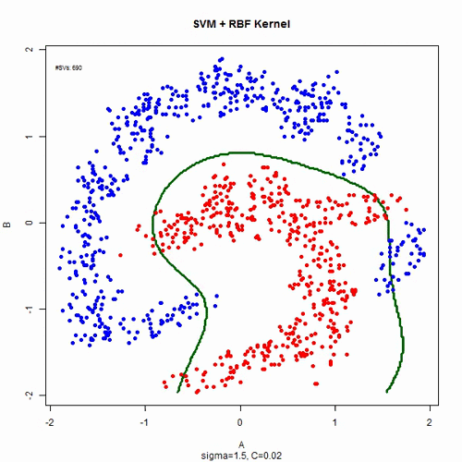
Binary Classification
Task of classifying the elements of a given set into two groups
Determine whether or not an item has some property or characteristics
ML.NET examples:
Sentiment analysis (is text positive)
Spam detection (spam or not)
Fraud detection (fraud or not)
Heart disease detection (has disease)
Lots of built-in algorithms (binary trainers)
LightGbm, AveragedPerceptron, FastTree, LinearSvm, FieldAwareFactorizationMachine, LbfgsLogisticRegression, SdcaLogisticRegression, SgdCalibrated, SgdNonCalibrated, …

Slide 10
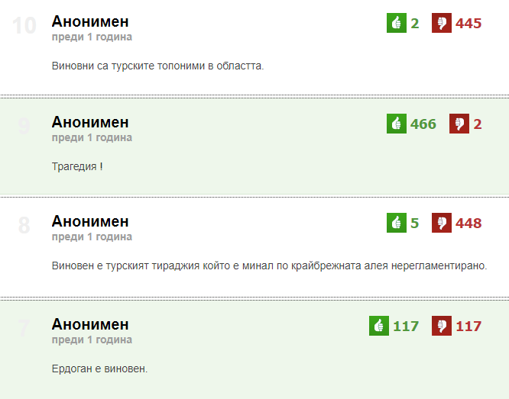
Example: Toxic or not dnes.bg comments
Predict if a text comment will get positive or negative votes
All comments are in Bulgarian
Data source: https://www.dnes.bg/
Data file: link (zip, 650000+ rows)
Scraped total of 8.7M comments
Only strongly positive/negative comments used
Input: Content (string) and IsPositive (bool)
Algorithm:
LbfgsLogisticRegressionBinaryTrainer [wiki]
Demo code: link

Slide 11
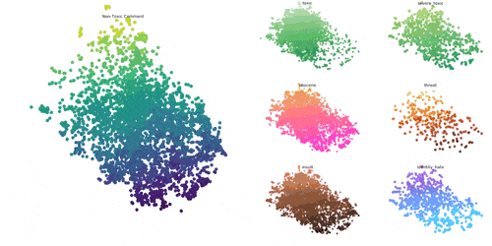
Multi-class Classification
Problem of classifying objects into one of three or more possible classes
Using one or more input variables
Real-life examples:
Movie genre prediction by the text description
Given a chemical analysis of wines predict the wine type
Music genre prediction by using the spectrogram data
ML.NET examples:
GitHub issues labeler
Iris flowers classification
Pixeled images of handwritten digits

Slide 12
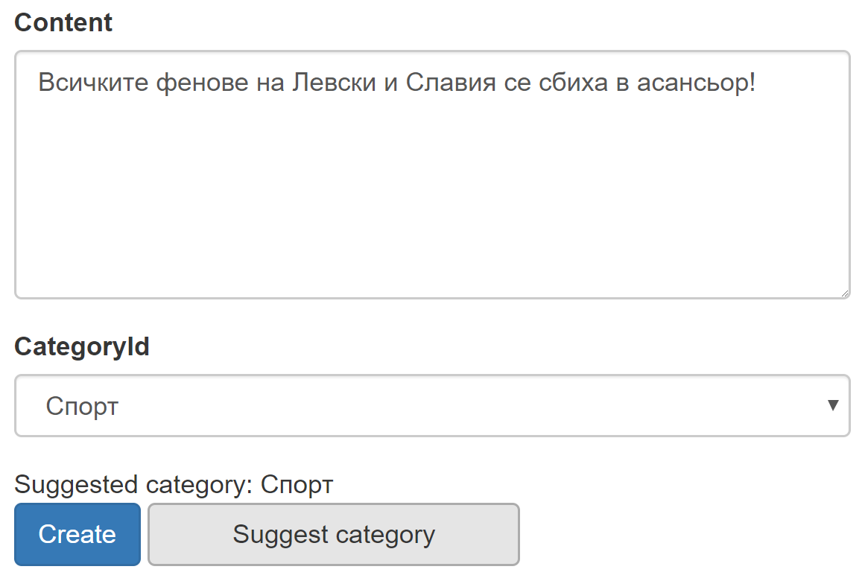
Example: Bulgarian Jokes Categorization
Problem: Categorize new jokes into existing categories
Data source: https://fun.dir.bg/
Data file: link (24771 rows)
Input:
Content (string) – in Bulgarian
Category (string) – 167 unique categories
Algorithm: SdcaMaximumEntropy
SDCA = Stochastic Dual Coordinate Ascent [papers]
Output: Category, Array of scores
Demo code: link

Slide 13
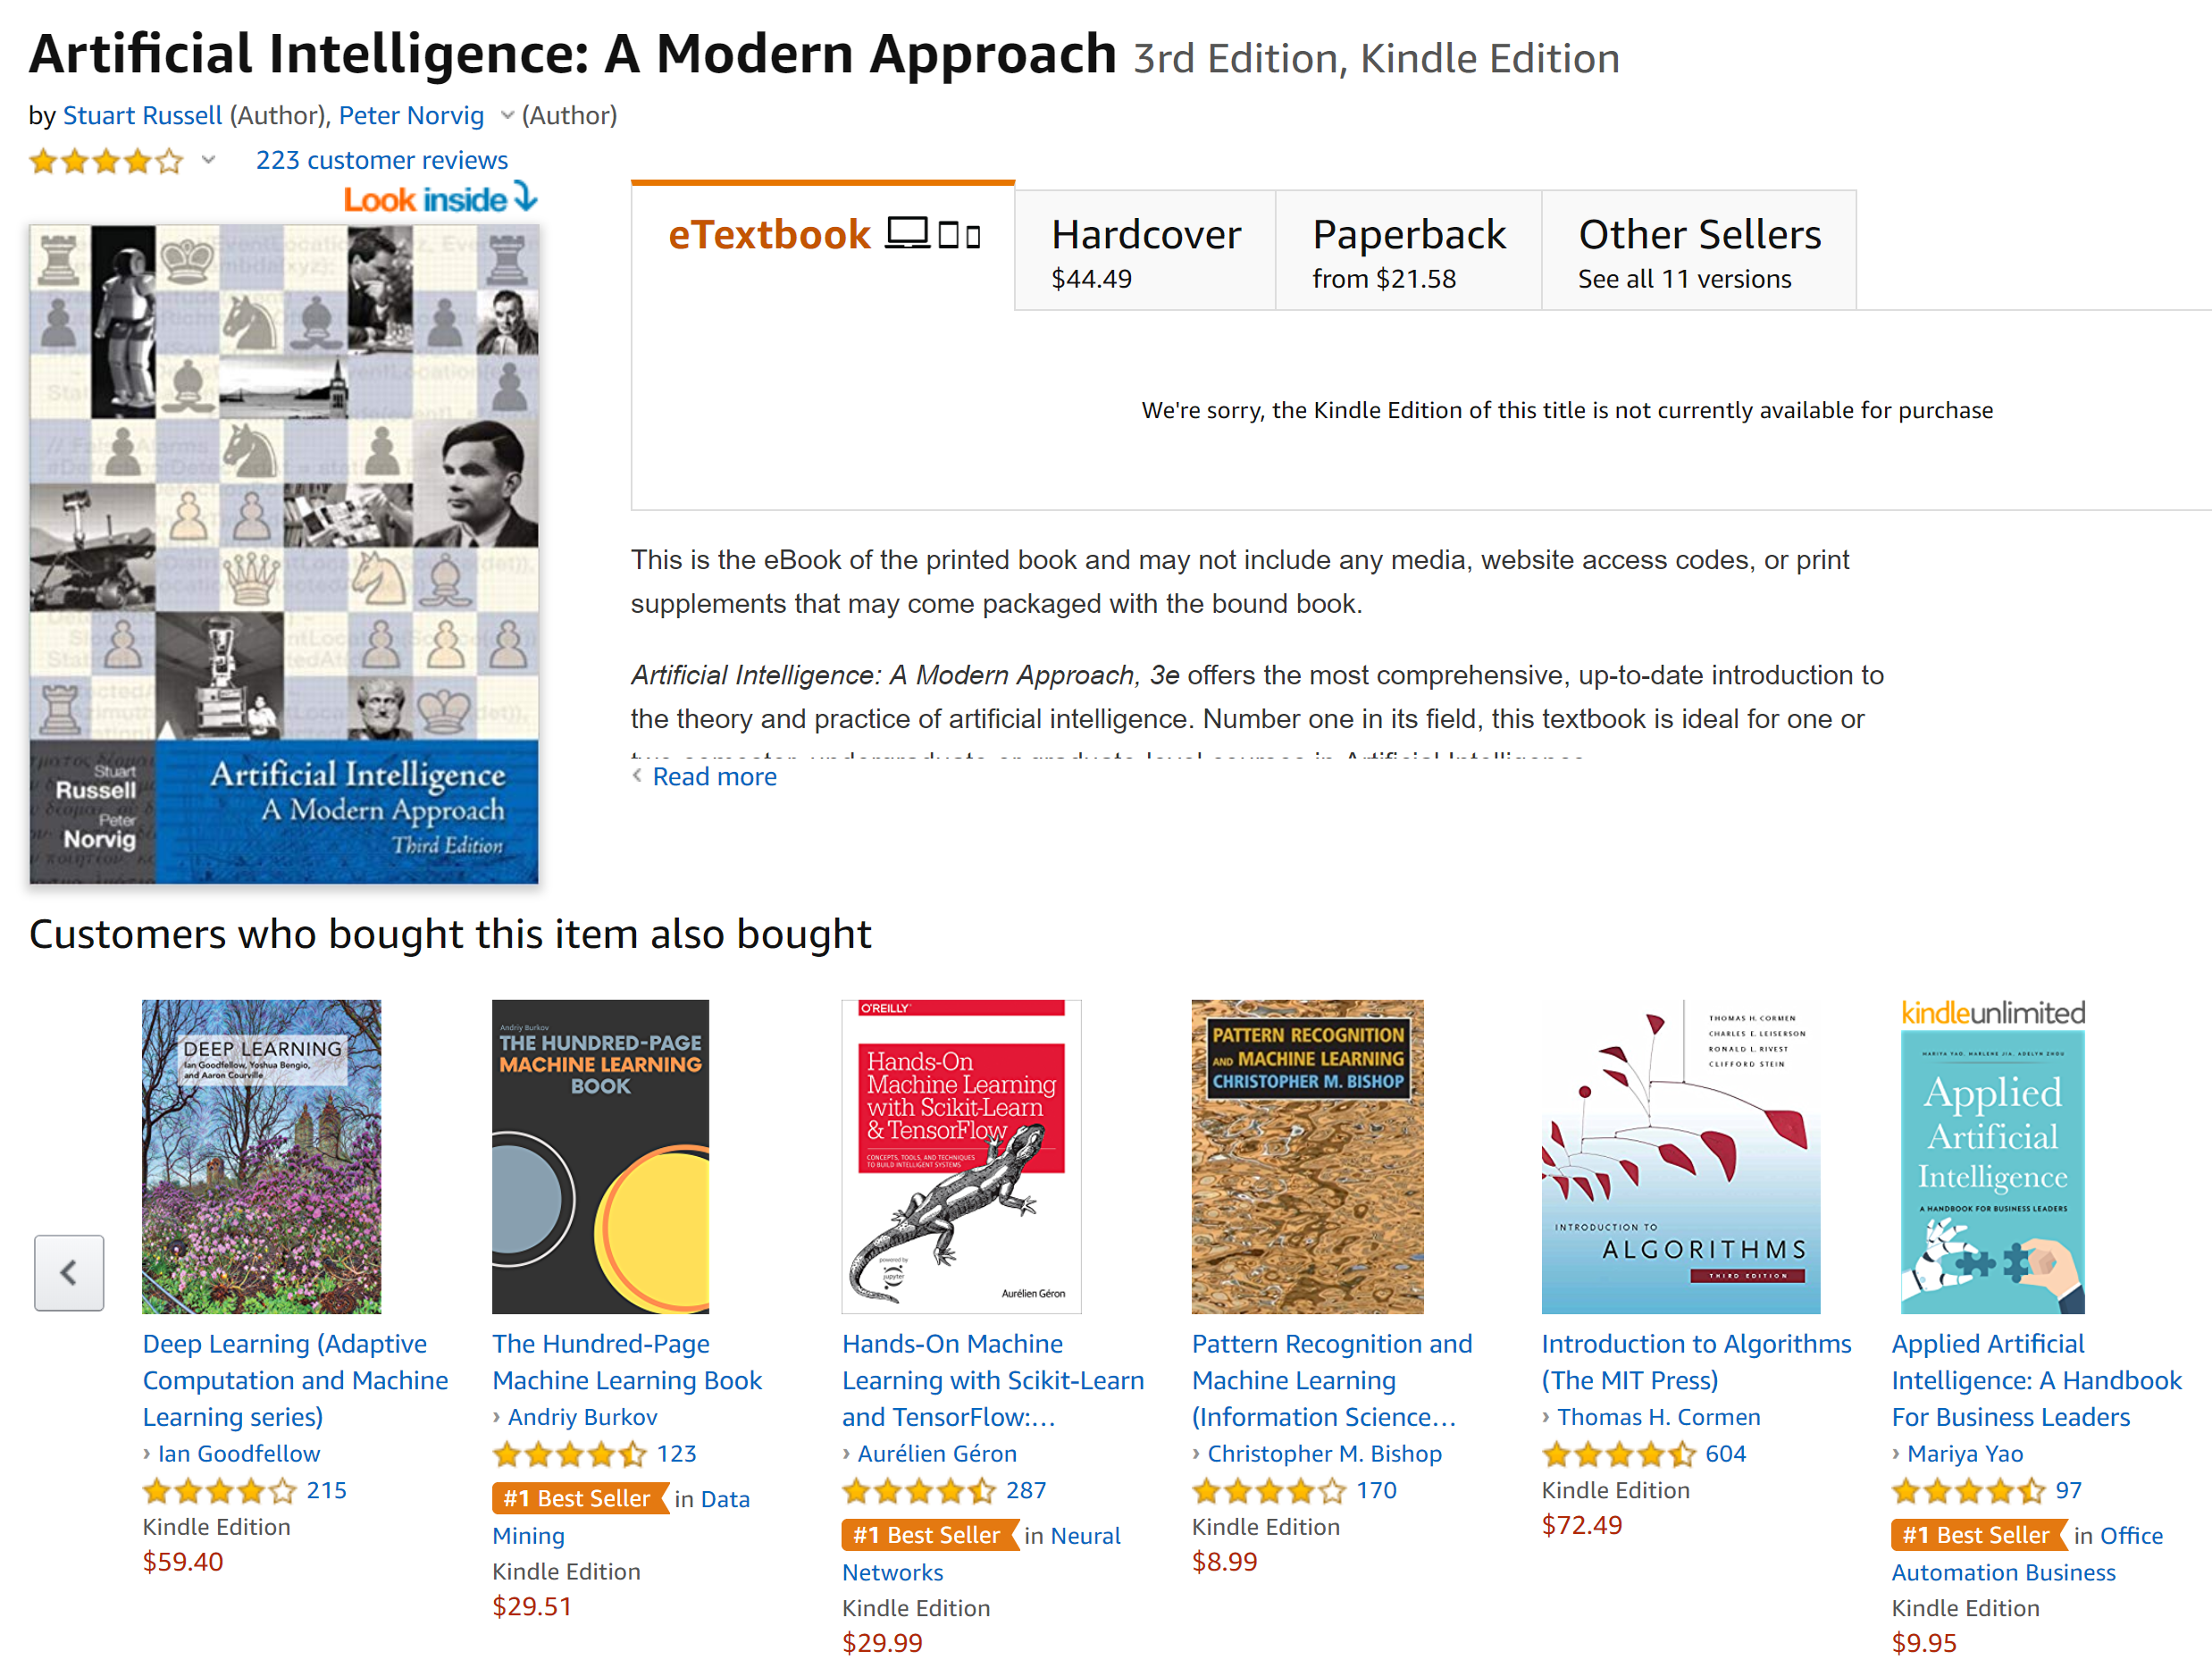
Recommendation
Predict the "rating" or "preference" a user would give to an item
Usually done with matrix factorization
Real-life examples:
Suggest a video (song) to play next
Predict if user will like a movie based on his ratings for other similar movies
Suggest items for social media news feed
ML.NET examples:
Product recommendation
Movie recommender

Slide 14
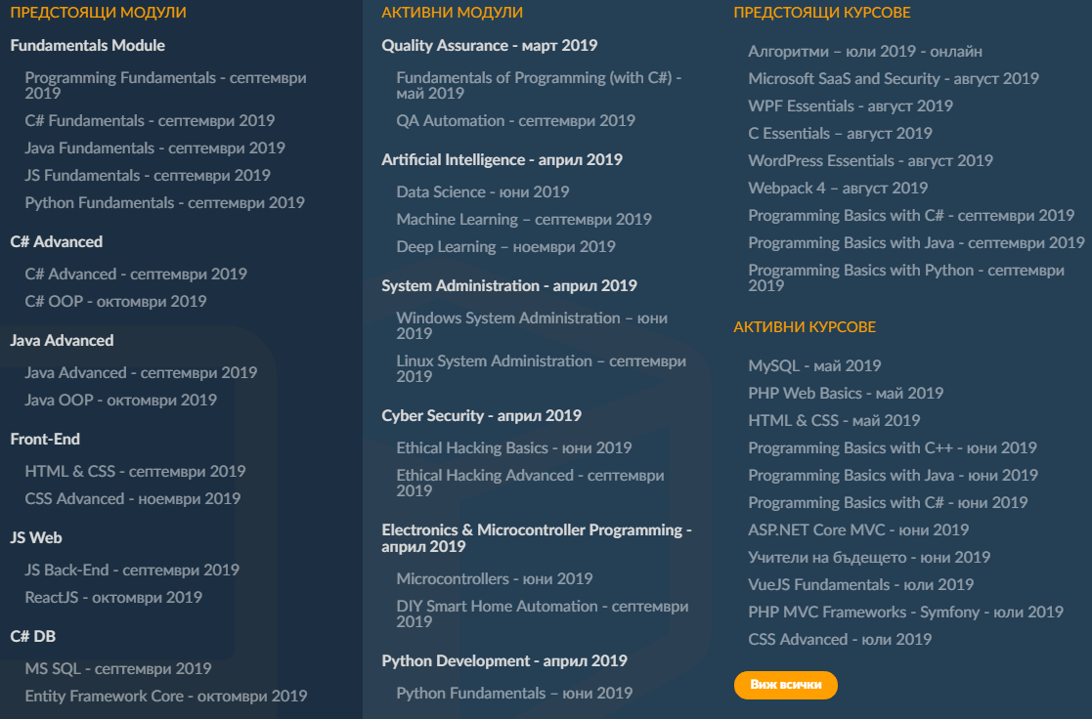
Example: SoftUni Courses Recommendation
Problem: Recommend new courses for a given user
Data source: SoftUni
Input: UserId (fake, int), CourseId (int)
Data file: 138574 rows
Algorithm: MatrixFactorization
Package: Microsoft.ML.Recommender
Output: For each user and course we get a score [0-1] how recommended this course is for the given user
Demo code: link

Slide 15
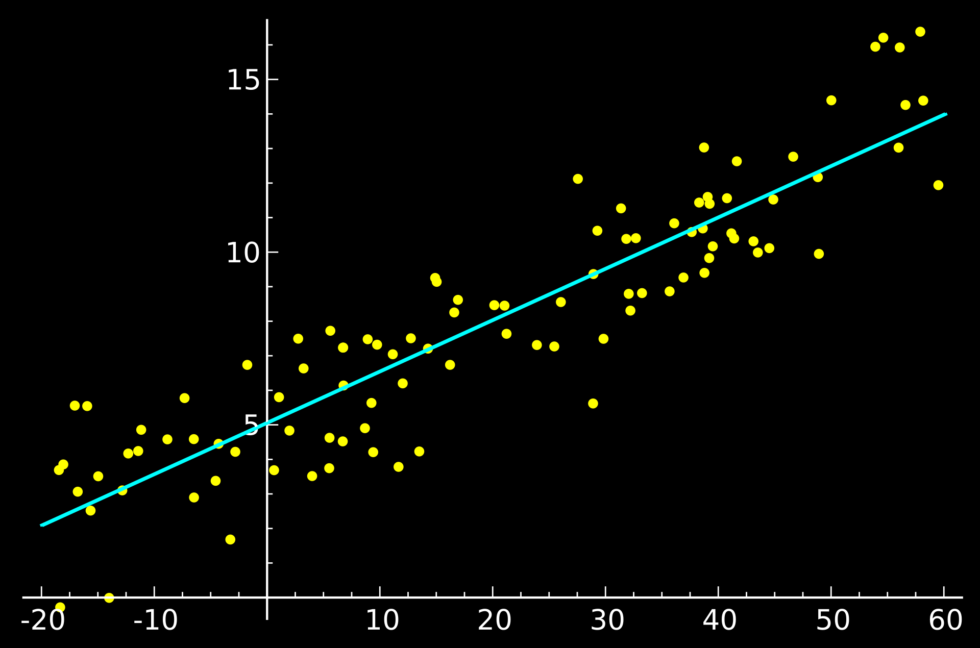
Regression (Predicting Values)
Regression analysis is a set of statistical processes for estimating the relationships among variables
Real-life examples:
Predict the population growth (linear)
Predict a person salary by demographics
Predict Dota 2 win probability by game state
ML.NET examples:
Taxi Price Prediction
Sales Forecasting
Bike Demand Prediction

Slide 16
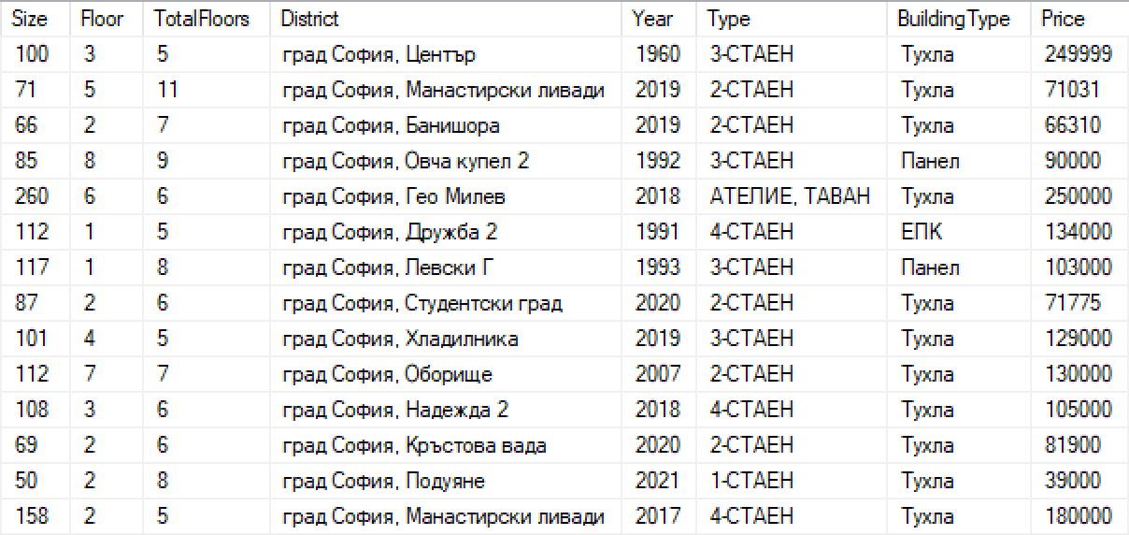
Example: Sofia properties price prediction
Problem: Predict the price of a property in Sofia by given information
Input: 7 parameters and Price
Output: Price (float, in EUR ☺)
Data source: https://imot.bg/
Data file: link (16083 rows)
Algorithm: Regression.Trainers.LightGbm Package: Microsoft.ML.LightGBM GBM = Gradient Boosting Machine
Demo code: link

Slide 17

Clustering
Grouping a set of objects in such a way that objects in the same group (cluster) are more similar to each other than to those in other groups/clusters
Unsupervised Machine Learning
Try to find meaningful structure / grouping
Real-life examples:
Group people in social media
Multivariate data from marketing surveys
In biology, genetics, medicine, chemistry, …
ML.NET examples:
Customer segmentation
Clustering iris data

Slide 18
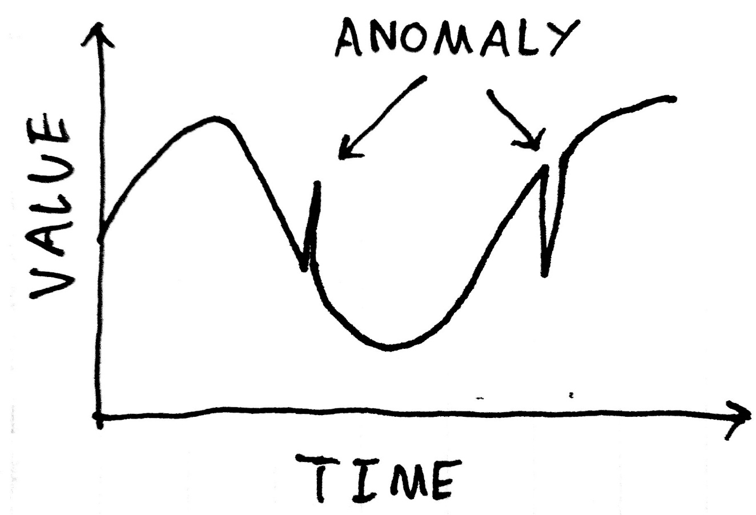
Anomaly Detection
Identification of rare items, events or observations which raise suspicions by differing significantly from the majority of the data
Real-life examples:
Detect outages, cyber-attacks, viral web content
Detect compromised accounts in Twitter
Detect fight in a bar using motion spikes in videos
ML.NET examples:
Sales spike detection
Power anomaly detection
NuGet package: Microsoft.ML.TimeSeries

Slide 19
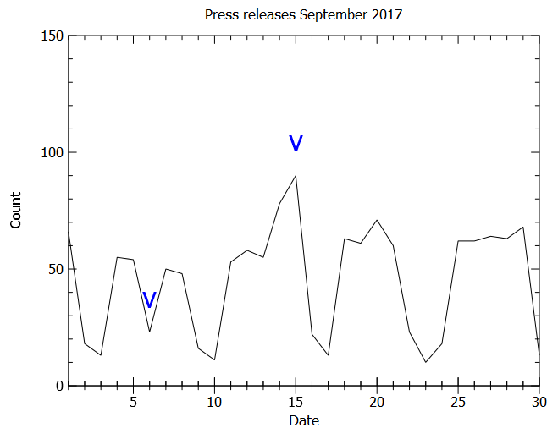
Example: Bulgarian Press Releases Spikes
Find spikes in press centers workload
Data source: https://presscenters.com/
Input: Date and Count for that date
Data file: link (730 rows)
Algorithm: Transforms.DetectSpikeBySsa
SSA = Singular spectrum analysis [wiki]
Output: For each input value we get:
Alert(yes or no), Score, P-Value(0-100)
Demo code: link

Slide 20
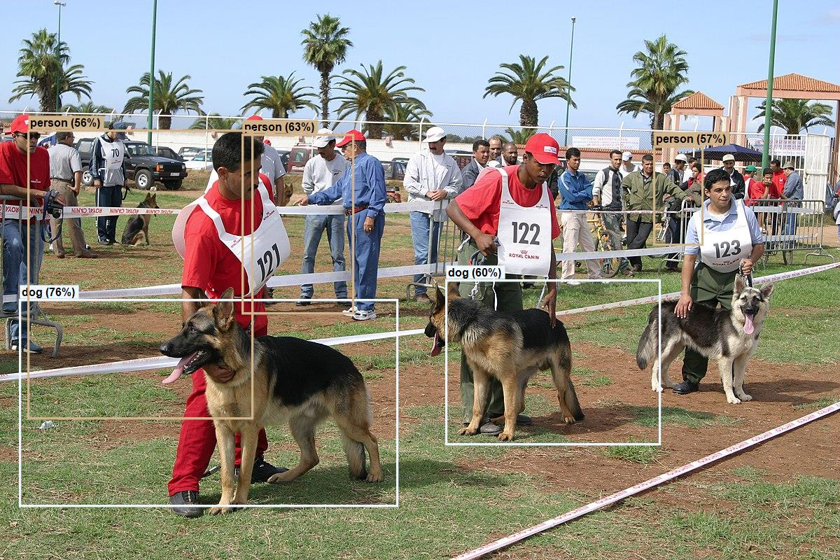
Computer Vision
High-level understanding of digital images
Real-life examples:
Detect what and where is on the image
Detect who is on the image (his eye/skin color)
Detect how far is something
What is the color of the traffic light
ML.NET examples:
Image classification – TensorFlow Model
TensorFlow pre-trained model (.pb files)
Object detection – ONNX model scoring
Using the Tiny Yolo2 in ONNX format

Slide 21
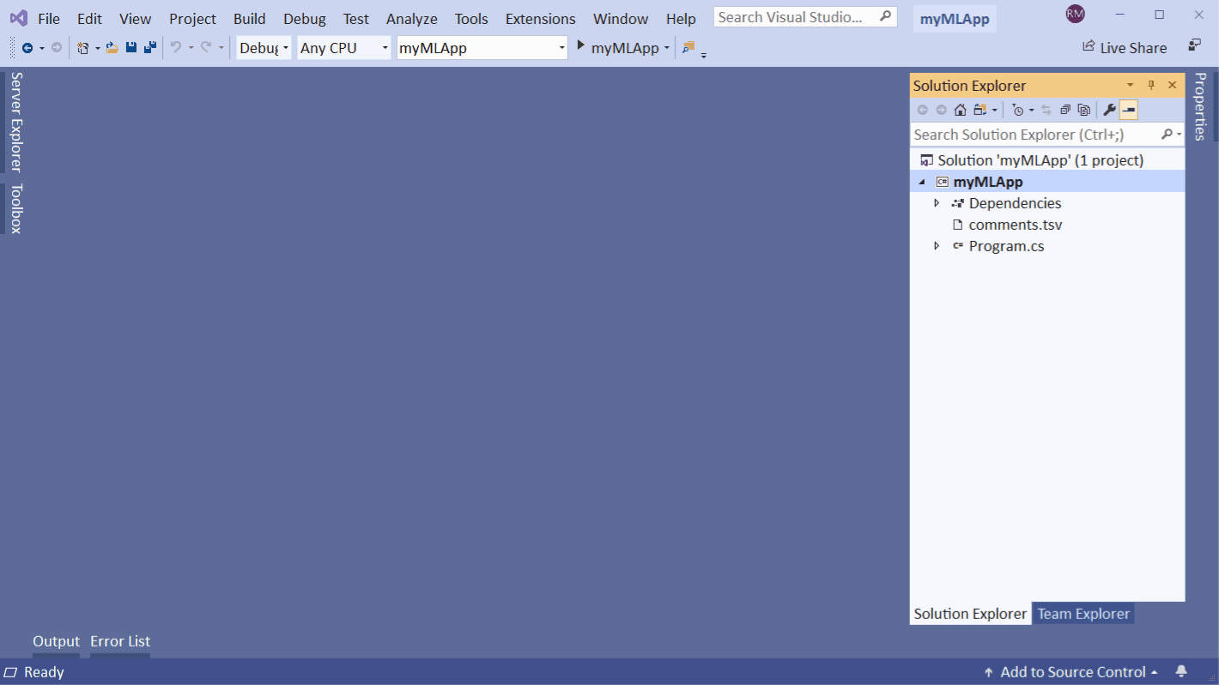
AutoML – Model Builder for ML.NET
Easy generate ML.NET code and create ML models with Model Builder (UI tool) and ML.NET CLI (console)
They both use AutoML
Automates the process of building best performing models
Steps to use it:
Install the ML.NET Model Builder extension for Visual Studio
Choose ML scenario
Load the data file
Wait AutoML to select the algorithm

Slide 22
ML.NET Models in ASP.NET Core
Install Microsoft.Extensions.ML
Register AddPredictionEnginePool in ConfigureServices():
Inject the PredictionEnginePool:
Use it:
services.AddPredictionEnginePool<InputModel, PredictionModel>()
.FromFile("MLModels/ModelFile.zip");
public PredictController(PredictionEnginePool<InputModel, PredictionModel> predictionEnginePool) { … }
PredictionModel prediction = this.predictionEnginePool.Predict(input);

Slide 23
Useful Links
Demo Code:
github.com/NikolayIT/ArtificialIntelligencePlayground/tree/master/ML.NET
ML.NET Official Page:
https://dotnet.microsoft.com/apps/machinelearning-ai/ml-dotnet
ML.NET Source Code:
https://github.com/dotnet/machinelearning
ML.NET Samples:
https://github.com/dotnet/machinelearning-samples
UWP and ML.NET Samples:
https://github.com/XamlBrewer/UWP-MachineLearning-Sample
More Samples:
github.com/dotnet/machinelearning/tree/master/docs/samples/Microsoft.ML.Samples

Slide 24

Summary
Machine Learning
Types of Machine Learning
ML.NET
Binary Classification
Multi-class Classification
Recommendation
Regression
Clustering
Anomaly Detection
Computer Vision
AutoML and ML.NET for ASP.NET Core
…
…
…

Slide 25
https://softuni.bg/trainings/courses

Slide 26












SoftUni Diamond Partners

Slide 27




SoftUni Organizational Partners

Slide 28




Trainings @ Software University (SoftUni)
Software University – High-Quality Education and Employment Opportunities
softuni.bg
Software University Foundation
http://softuni.foundation/
Software University @ Facebook
facebook.com/SoftwareUniversity
Software University Forums
forum.softuni.bg

Slide 29

License
This course (slides, examples, demos, videos, homework, etc.) is licensed under the "Creative Commons Attribution-NonCommercial-ShareAlike 4.0 International" license

